Slide 1
Antialiasing
Foley – 3.17 (Chapter 3)

Slide 2
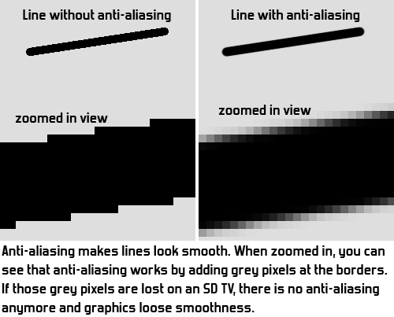
What is Antialiasing?
Aliasing
Approximating a continuous entity with discrete samples
Jagging / staircasing effect
Result of an all-or-nothing approach to scan conversion
Each pixel is either colored or left unchanged
Antialiasing
The application of techniques that reduce or eliminate aliasing

Slide 3
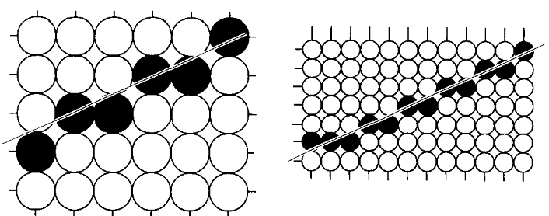
Antialiasing Techniques
Increase Screen Resolution
Costly
Only diminishes, does not solve
Higher memory
More time for scan-conversion
(a) res. W X H (b) res. 2W X 2H
Area Sampling
Unweighted Area Sampling
Weighted Area Sampling

Slide 4
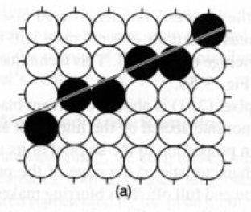
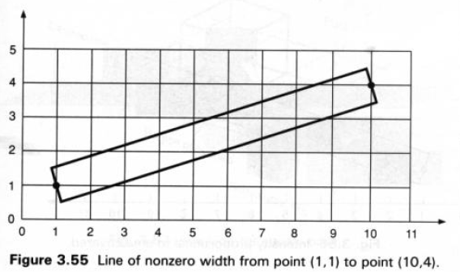
Unweighted Area Sampling
Basic Idea:
Horizontal or vertical line passes through one pixel per row or column
Lines at other angles go through multiple pixels per row or column
A line is considered as a rectangle of a desired thickness covering a portion of the grid

Slide 5
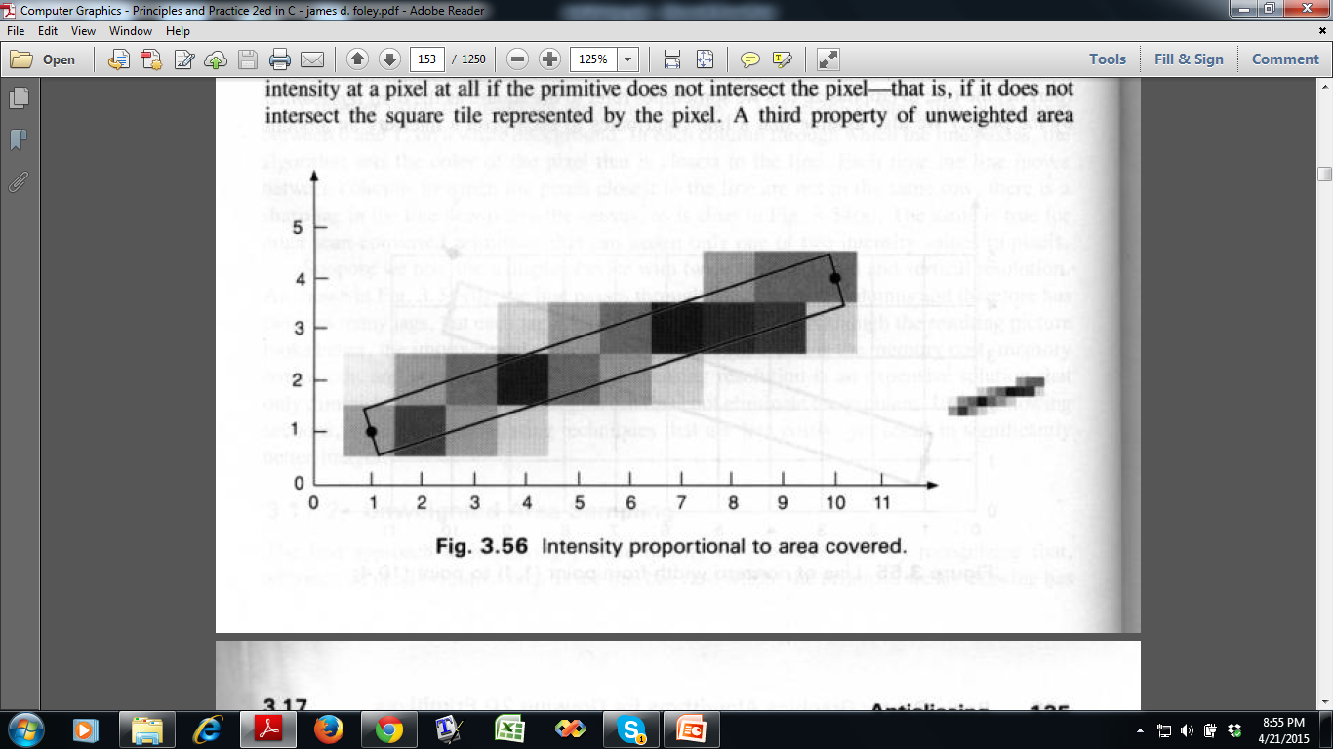
Unweighted Area Sampling
Basic Idea:
Pixels on the grid overlapped by the rectangle are colored to an appropriate intensity. General rule : A line contributes to each pixel’s intensity an amount proportional to the percentage of the pixel’s tile it covers.
75%
25%
95%

Slide 6
Unweighted Area Sampling
Intensity of pixel centered at (x,y) :
I_{x,y} = I _{max} . dA . Weight
dA = area overlap for pixel at (x,y)
Weight = 1 for unweighted area sampling

Slide 7
Unweighted Area Sampling
Properties :
The intensity decreases with decreased area overlap.
Primitive cannot influence the intensity at a pixel if the primitive does not intersect it.
Equal areas contribute equal intensity, regardless of distance from pixel center to area.
Overlapping area is nearer
Overlapping area is farther

Slide 8
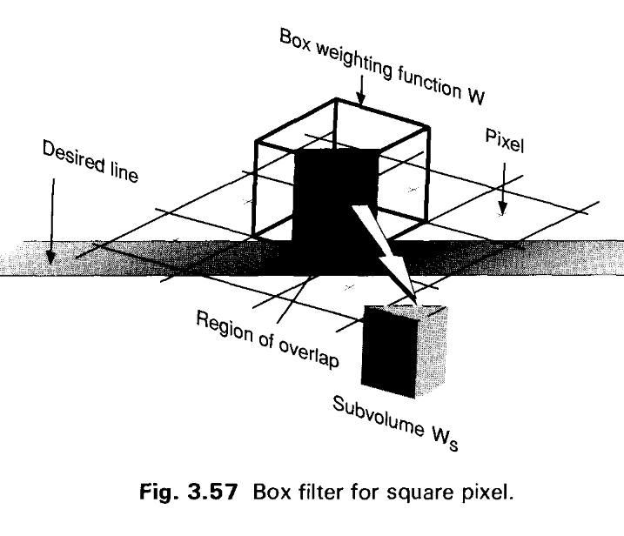
Unweighted Area Sampling
Weighting Function
Uniform weight for equal overlapping area

Slide 9
Weighted Area Sampling
Properties :
First and second properties are unchanged
Property 3 has been modified as:
Equal areas contribute unequally : A small area closer to the pixel center has greater influence than does one at a greater distance.

Slide 10
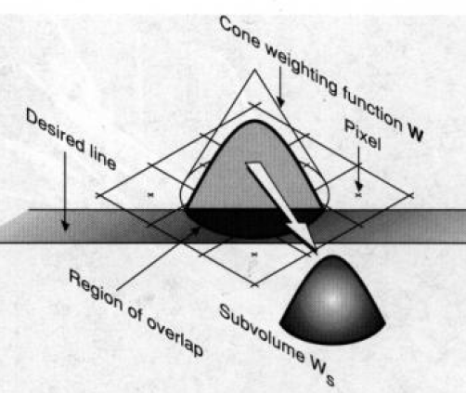
Weighted Area Sampling
Remember, the intesity for unweighted area sampling
Intensity of pixel centered at (x,y)
I_{x,y} = I _{max} . dA . Weight
Now, we need to construct a weighting function that gives less weight to area further away from pixel center than it does to equal but closer one.
So weighting must be a decreasing function of distance.
A circular cone is an example of such a function.

Slide 11
Weighted Area Sampling
To obtain such weighting, pixels are considered as circles.
Each pixel is considered to have a conical volume.
Intensity at pixel (x,y)
I _{x,y} = I _{max} . W_{s}
where W_{s} is the sub volume of cone

Slide 12
Weighted Area Sampling
Each circular pixel has radius of 1 unit so the pixels will be overlapping
Ensures that no area in the grid is left uncovered by the pixels
Notes:
Theoretical proofs and optimality about 1 unit radius are provided in Ch 14 (out of syllabus)

Slide 13
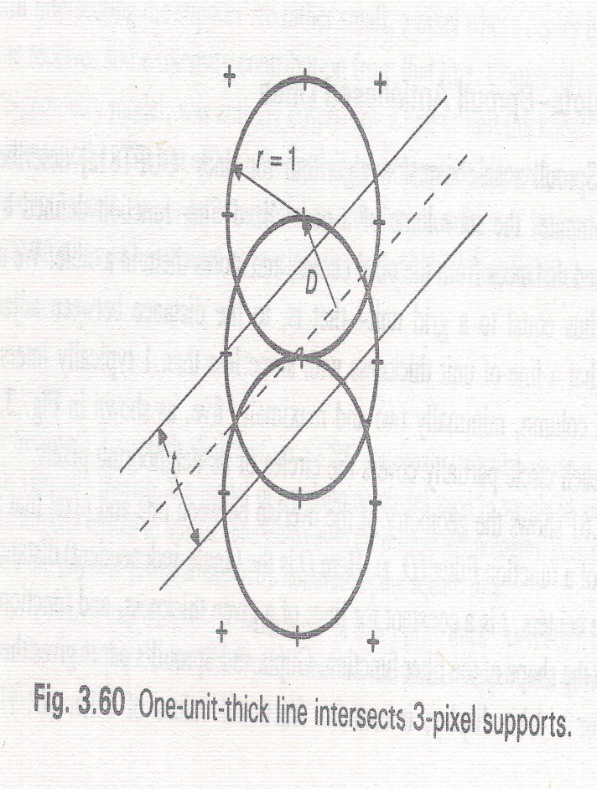
Weighted Area Sampling
Each line intersects more than one pixel
Usually three pixels
Notes:
Theoretical proofs and optimality about 1 unit radius are provided in Ch 14 (out of syllabus)

Slide 14
Gupta-Sproull Weighting Function
Uses Gupta-Sproull weighting function, Filter(D, t)
D = Perpendicular distance between pixel center and the line center
t = Constant for a line of given thickness
A table takes distance D as index and provides corresponding Filter(D, t) value i.e. Intensity.
Line center

Slide 15
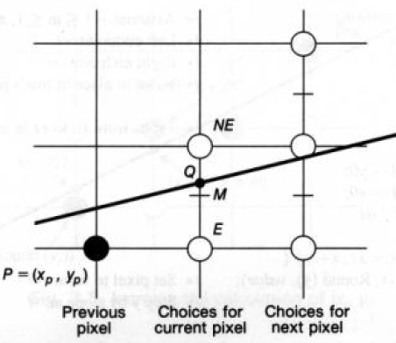
Gupta-Sproull Antialiased Lines
Modifies the midpoint line algorithm for scan converting lines
The decision variable d is used as before to choose between E and NE
Then Distance D between the chosen pixel to the line is computed
Using D, distances between its two vertical neighbors and the line: D_{up}, and D_{down} are computed
Then intensity of chosen pixel and its two vertical neighbors are set, on the basis of the distances from these pixels to the line, using Filter(D, t)
Chosen Pixel
Line center
D_{up}
D
t
D_{down}

Slide 16
Midpoint Line Algorithm - Recap
Initially we are at P(x_{p},y_{p})
Choose between NE and E
Midpoint M is (x_{p}+1, y_{p}+1/2)
M lies on which side of the line?
M is on the line → any pixel NE/E
M is below the line → choose NE
M is above the line → choose E
Find the equation of the line f (x,y)
f (x,y) = ax + by + c a = dy; b = -dx; c = dx.B (B is the y-intercept)
Let, d = f (M) = f (x_{p}+1, y_{p}+1/2)
d = 0 → M is on the line d > 0 → M is below the line d < 0 → M is above the line

Slide 17
Midpoint Line Algorithm - Recap
Initial value of decision variable d_{start}
Start point (x_{o},y_{o})
d_{start} = f (x_{o}+1, y_{o}+ 1/2)
= f (x_{o}, y_{o}) + dy - dx/2 = dy - dx/2
Here the fraction in dx/2 can be avoided by
considering f(x,y) = 2(ax+by+c)

Slide 18
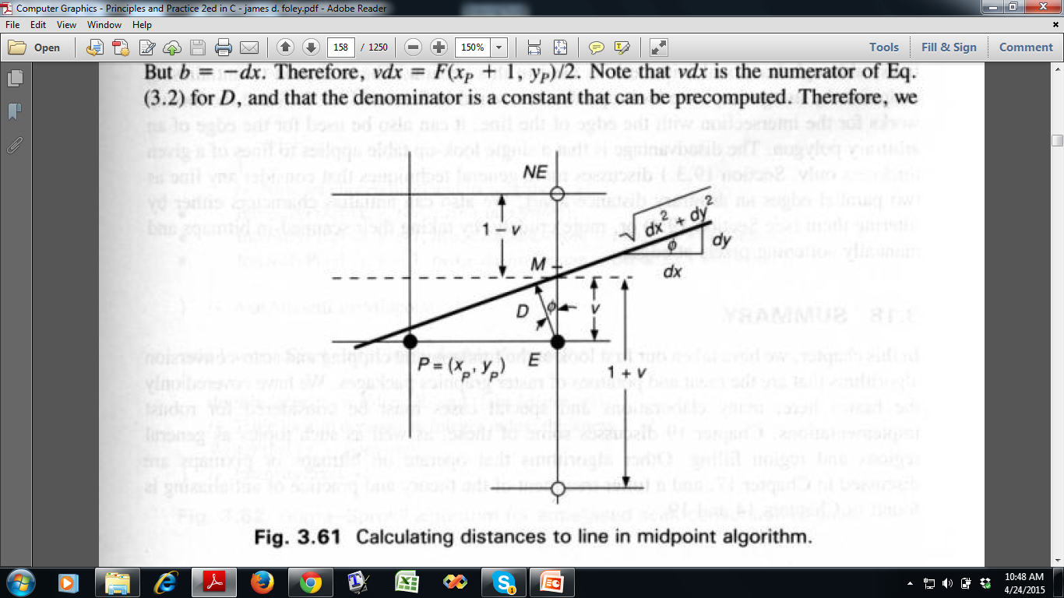
Gupta-Sproull: Calculation of D and v
The decision variable d is used as before to choose between E and NE
D = perpendicular distance between chosen pixel (E) and line center
v = Vertical distance between chosen pixel (E) and line center
Line center

Slide 19
Calculation of D
For E,
D = perpendicular distance between chosen pixel (E) and the line center
We know slope dy/dx
Apply the law of similar triangle

Slide 20
Calculation of v
For E,
v = vertical distance between chosen pixel (E) and line center
+ve if line center passes above the chosen pixel
-ve if line center passes below the chosen pixel
consider the absolute value

Slide 21
Calculation of v
v = vertical distance between chosen pixel (E) and line center
vertical distance = subtraction of y of E from y of the intersecting point
Go from P = (x_{p},y_{p}) to E = (x_{p}+1,y_{p})
v = y of line at x_{p}+1 - y of E at x_{p}+1 = y’ – y_{p}
How to get y’ ?
Equation of Line, ax+by+c=0
=> y = -(ax+c)/b
So, y’=-(a(x_{p}+1)+ c)/b
y’
y_{p}

Slide 22
Calculation of v
From v = y’ – y_{p} we can derive, vdx = a(x_{p}+1) + by_{p}+ c
For avoiding fraction,
2vdx = 2(a(x_{p}+1) + by_{p}+ c)
2vdx = f(x_{p}+1,y_{p})
2vdx = 2(a(x_{p}+1) + b(y_{p}+½) + c) - b
2vdx = f(x_{p}+1,y_{p}+1/2) – b = d – b = d + dx
y’
Present In terms of M = d_{old} = f(x_{p}+1,y_{p}+1/2)
y_{p}

Slide 23
Calculation of D_{up}, D_{down}
So we have D, and v for selected pixel E
Now, find D for upper and lower pixels

Slide 24
Calculation of D and v
For NE,
2vdx = f(x_{p}+1,y_{p}+1)
= 2(a(x_{p}+1) + b(y_{p}+1) + c)
vdx = a(x_{p}+1) + b(y_{p}+1) + c
= (a(x_{p}+1) + b(y_{p}+1/2) + c ) + ½ b
= f(x_{p}+1,y_{p}+1/2)/2+ ½ b
= d/2 + b/2 = (d+b)/2
Chosen Pixel
Also find the values of D for
The pixel above NE and
The pixel below NE

Slide 25
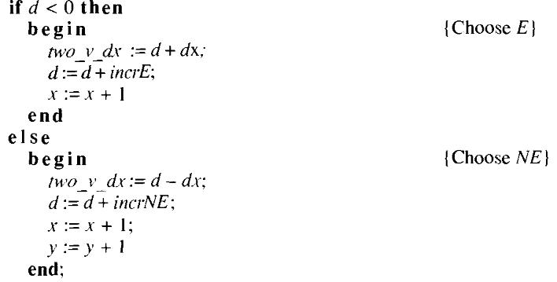

Gupta-Sproull Algorithm
Modification of Midpoint line algorithm
Pseudocode: Figure 3.62 of textbook
…

Slide 26
Thank you ☺

